Slide 1
Introduction to Cite-Checking
Northeastern University Law Review
Application Preparation Sessions

Slide 2
Logistics & Program Notes
The online presentation of this session is recorded
The recording will be paused during breakout rooms/group work
The slideshow, worksheet, and answer sheet will be posted to NULR's website
http://nulawreview.org/resources-for-applicants-1
Questions? Email Allison (jordan.alli@northeastern.edu) or Dustin (haigler.d@northeastern.edu)

Slide 3
Agenda
Fact Checking Refresher
Cite-Checking
Wrap-up
Practice

Slide 4
Fact-Checking Refresher

Slide 5
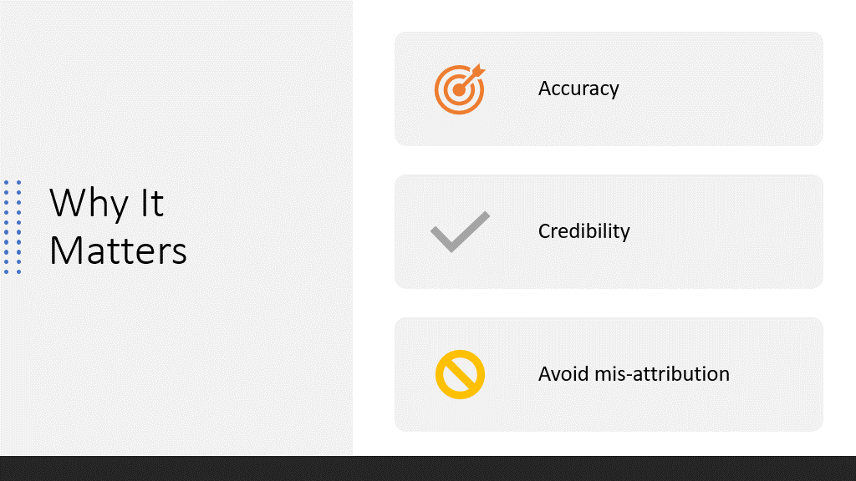
Fact-checking

Slide 6
How to Fact-check

Slide 7
Cite-Checking

Slide 8
Lesson Plan
Navigating the Bluebook
How to Cite-Check
Practice
Review

Slide 9
Navigating the Bluebook

Slide 10
Navigating the Bluebook: Breakdown of Rules
Rule 1-9: Formatting Rules
Rule 1: Structure and Use of Citations
Rule 2: Typeface for Law Reviews
Rule 3: Subdivisions
Rule 4: Short Citation Forms
Rule 5: Quotations
Rule 6: Abbreviations, Numerals. and Symbols
Rules 7: Italicization for Style and in Unique Circumstances
Rule 8: Capitalization
Rule 9: Titles of Judges, Officials and Terms of Court
Rule 10-21: General/Controlling Rules
Rule 10: Cases
Rule 11: Constitutions
Rule 12: Statutes
Rule 13: Legislative Materials
Rule 14: Administrative and Executive Materials
Rule 15: Books, Reports, and Other Nonperiodic Materials
Rules 16: Periodical Materials
Rule 17: Unpublished and Forthcoming Sources
Rule 18: The Internet, Electronic Media, and Other Nonprint Resources
Rule 19: Services
Rule 20: Foreign Material
Rule 21: International Material

Slide 11
Navigating the Bluebook: Most Common Rules
Rule 1.2: Signals
Rule 4: Short citations
Rule 5: Quotations
Rule 8: Capitalization
Rule 10: Cases
Rule 12: Statutes
Rule 16: Periodical materials
Rule 16.4: Consecutively paginated journals
Rule 16.5: Nonconsecutively paginated journals
Rule 18: Online only/nonprint sources

Slide 12
Navigating the Bluebook: Break Down of Tables
T1: United States Jurisdictions
T2: Foreign Jurisdiction (available online only)
T3: Intergovernmental Organizations
T4: Treaty Sources
T5: Arbitral Reporters
T6: Common Words in Case Names, Institutional Author Names, and Periodical Titles
T7: Court Names
T8: Explanatory Phrases
T9: Legislative Documents
T10: Geographical Terms
T11: Judges and Officials
T12: Months
T13: Institutional Names in Periodical Titles
T14: Publishing Terms
T15: Services
T16: Subdivisions

Slide 13
How to Cite-Check

Slide 14
Cite-Checking Steps
Step 1: What type of authority is the source in this citation?
This informs what BB rule applies. See back cover of BB for list of rules and the category of sources that are covered in each rule.
Step 2: Is a long or short cite appropriate here?
Look around the draft/document to determine this. If it's a case, was it mentioned in the last five footnotes? Is a supra or id. Appropriate?
Note: short citations are not just covered by R4—look at the end of the general rule for the detailed short cite rule for that source.

Slide 15
Cite-Checking Steps
Step 3: What are all the rules that apply?
Rules 10-18 guide how to format the citation according to case/book/article etc., but also (for instance):
Signals and parenthetical info in R1
Typefaces under R2
Quotations and any alterations to quotes under R5
Abbreviations and spacing under R6
Tables for abbreviations (e.g. T6, T10, T13)
Step 4: Check the citation against each of the relevant rules (note which rule(s) apply).

Slide 16
Cite-Checking Steps
Step 5: Record the rules that the citation applies incorrectly.
Explain the necessary change and what rules the change is based on.
Bold the rules.
Step 6: Record the revised cite with the changes in red.
Note: Documenting changes is required for Law Review assignments (and the application). It is not necessary for your own work but might help you remember rules and prevent errors.

Slide 17
Common Mistakes
Not using the correct reporter for a case
Not abbreviating periodical reporter names per T6 (E.g. Journal of Public Health Policy > J. Pub. Health Pol'y).
Using the wrong typeface
Using a comma after a signal (E.g. "See, Jane Goodall...), unless it is See, e.g.,
Incorrect supra use
Incorrect titles to article or book names
Not including editors and translators for books

Slide 18
Best Practices
Always use the Bluebook (don't rely on memory!)
Always read through the entire rule
Always check cross-referenced rules and tables
Remember Rules 1-9 (style rules that almost always apply)
The index is your friend

Slide 19
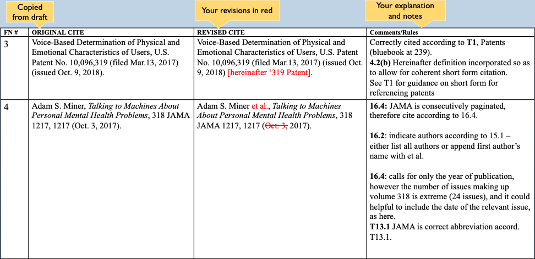
Notes:
Please note that these examples are based on the 20th edition of the Bluebook; JAMA is no longer abbreviated according to T13.

Slide 20
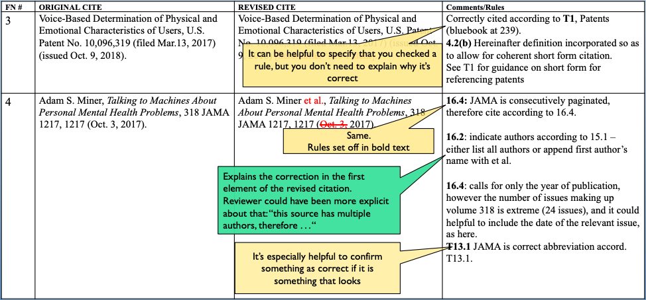
out of place
Notes:
Please note that these examples are based on the 20th edition of the Bluebook; JAMA is no longer abbreviated according to T13.

Slide 21
Examples

Slide 22
Example 1
Rules:
Controlling rule: Rule 15
Author's full name: F. Scott Fitzgerald
Title: The Great Gatsby
Page cited (pincite): 117
Year of Publication: 1925
Rule 15.4(a)(iii): Publisher if not the original, and date of publication of edition cited: Scribner 2004
Rule 2.1(b): Large and small capitals for both author and title: F. Scott Fitzgerald, The Great Gatsby
Rule 3.2(a): Give the page number before the date parenthetical, without an introductory abbreviation like "p.": 117
Original Citation:
F. Scott Fitzgerald, Great Gatsby, p. 117, Scribner (2004)
Corrected Citation:
F. Scott Fitzgerald, The Great Gatsby 117 (Scribner 2004) (1925).

Slide 23
Example 2
Rules:
Controlling rule: Rule 4.2(a)
Author last name: Adler
Comma
"supra"
Footnote in which full citation can be found: note 8
Comma
at [manner in which subsequent citation differs from the former – volume, paragraph, section, page number]: at 32.
Rule 1.2: No comma after "see"
Original Citation:
See, Matthew D. Adler, n.8 at 32.
Corrected Citation:
See Adler, supra note 8, at 32.

Slide 24
Application Examples

Slide 25
Footnote 1
See, Kendall, Brent, Judge Allows Travel-Industry Deal, Rejecting Justice Department Antitrust Complaint, The Wall Street J., (last visited April 12, 2020).

Slide 26
Footnote 1 Answer
Corrected Citation
See Brent Kendall, Judge Allows Travel-Industry Deal, Rejecting Justice Department Antitrust Complaint, Wall St. J. (Apr. 8, 2020, 3:57 PM), https://www.wsj.com/articles/judge-allows-travel-industry-deal-rejecting-justice-department-antitrust-complaint-11586375871.
Original Citation
See, Kendall, Brent, Judge Allows Travel-Industry Deal, Rejecting Justice Department Antitrust Complaint, The Wall Street J., (April 8, 2020).
Rule 18.2.1(b)(ii): online sources with print characteristics, such as an online newspaper article, should have the URL appended.
Rule 18.2.2(a): Abbreviate the name of an institutional author according to rule 15.1(d), which says to use table T6 and T10. According to T6, “Street” should be abbreviated to “St.” and “the” should be omitted.
Rule 18.2.2(c): It is recommended that citations for internet sources include a timestamp whenever possible.
Other: author names should be ordered first, last; no comma between institutional author and date parenthetical; no comma between “See” and the author; “April” should be abbreviated to “Apr.”

Slide 27
Footnote 2 Practice
Confirmation Hearings of Ruth Bader Ginsberg, S. Hr’g 103–482 at 40–41 (July 20–23, 1993) (statement of Sen. Dianne Feinstein), https://www.loc.gov/law/find/nominations/ginsburg/hearing.pdf.

Slide 28
Footnote 2 Answer
Corrected Citation
Nomination of Ruth Bader Ginsburg, to Be Associate Justice of the Supreme Court of the United States: Hearings Before the S. Comm. on the Judiciary, 103d Cong. 40–41 (1993) (statement of Sen. Dianne Feinstein).
Original Citation
Confirmation Hearings of Ruth Bader Ginsberg, S. Hr’g 103–482 at 40–41 (July 20–23, 1993) (statement of Sen. Dianne Feinstein), https://www.loc.gov/law/find/nominations/ginsburg/hearing.pdf.
Rule 13.3(a): citation to federal committee hearing should include the entire subject matter title as it appears on the cover, the committee name, the number of Congress, the page number of the particular material being cited, and the year of publication.
Committee meetings may be abbreviated according to tables T6, T9, and T10. According to T9, “Committee” should be abbreviated as “Comm.”
Rule 6.2(b)(ii): In citations, for figures representing ordinal numbers ending in the number three, use “3d,” not “3rd.”
Rule 18.2.1(a): When an authenticated, official, or exact copy of a source is available online, citation can be made as if to the original print source (without any URL information appended).
Other: “Congress” is abbreviated as “Cong.”; rule 13.3 indicates that titles should be italicized and that a comma should be inserted between the title and the number of Congress.

Slide 29
Practice http://nulawreview.org/resources-for-applicants-1

Slide 30
Navigation Questions
Question 1: Rule 3.2(a)
Question 2: Rule 2.1(a)
Question 3: Rule 6.2(c)
Question 4: Rule 12.9.3

Slide 31
Multiple Choice #1: Periodical
Answer Choice A: Chi Chi Wu, Automated Injustice: How a Mechanized Dispute System Frustrates Consumers Seeking to Fix Errors in Their Credit Reports, 14 N.C. Banking Inst. 139, 180–81 (2010).

Slide 32
Multiple Choice #2: Federal Statute (U.S. Code)
Answer Choice D: 15 U.S.C. §§ 1681e, 1681g.

Slide 33
Multiple Choice #3: Case
Answer Choice A: See, e.g., Chiang v. Verizon New Eng., Inc., 595 F.3d 26, 38 (1st Cir. 2010).

Slide 34
Multiple Choice #4: Book
Answer Choice C: Thomas A. Durkin et al., Consumer Credit and the American Economy 302–04 (2014).

Slide 35
Source #1: Online Newspaper Article
Will Wright, After Breonna Taylor’s Death, Black Engagement in Kentucky Politics Soared, N.Y. Times (Mar. 13, 2021, 7:04 PM), https://www.nytimes.com/2021/03/13/us/breonna-taylor-death-anniversary.html?action=click&module=News&pgtype=Homepage.

Slide 36
Source #2: Congressional Report
H.R. Rep. No. 117-7, at 18-19 (2021).

Slide 37
Wrap-up

Slide 38
Resources
Harvard Law School Library Bluebook Legal Citation System Guide: https://guides.library.harvard.edu/bluebook-guide
Georgetown Law Library Bluebook Guide: https://guides.ll.georgetown.edu/bluebook
University of Washington School of Law Bluebook Videos:
https://lib.law.uw.edu/bluebook101/videos

Slide 39
Workshop Materials
http://nulawreview.org/resources-for-applicants-1

Slide 40
Questions?
Email Allison (jordan.alli@northeastern.edu) or Dustin (haigler.d@northeastern.edu)

Slide 41
Thank You!

